Slide 1

Skin Lesion Classification using Deep Learning
Supervised by:
Name: Farzina Akther
Senior Lecturer,
Department of
Computer Science & Engineering
Presented by:
Name: Kaium Uddin
ID: CSE 01806657
&
Name: Shifat Hasan
ID: CSE 01806647

Slide 2
Outline
Introduction
Motivation
Objective
Related Work
Methodology
Dataset
Data preprocessing and Regularization techniques
Proposed systems
Results
Conclusion and Future Work
References

Slide 3
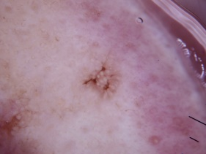
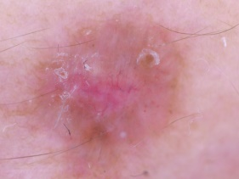
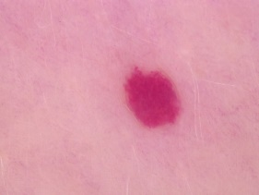
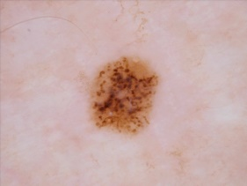
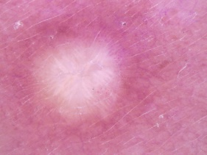
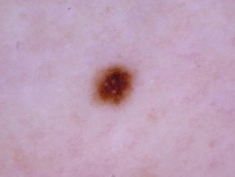
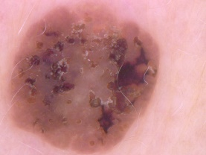
Introduction
Skin lesions are any area of your skin that's abnormal from the skin around it.
Skin lesions are common and are often the result of an injury or damage to skin, but some have the potential to be cancerous.
Fig: Some effected skin

Slide 4
Motivation
To provide an automated tool that can classify skin lesions,
Skin lesion image classification can help to assist dermatologists in the diagnosis of skin cancer,

Slide 5
Objectives
To develop a model which classify skin lesion images more accurately.
The model should be able to generalize well to unseen data and should not be overfitting the training data.

Slide 6
Related Work
Sl. | Paper Name | Author | Date and publication | Findings
01 | [1] Convolutional Neural Networks Using MobileNet for Skin Lesion Classification, November 2019, IEEE | Wannipa Sae-Lim, Wiphada Wettayaprasit, and Pattara Aiyarak | International Joint Conference on Computer Science and Software Engineering (JCSSE) 2019 Publisher: IEEE | Dataset: HAM10000 Class: 7 Up-sampling, augmentation applied on dataset Used mobile-net, modified mobile-net Accuracy : 79.23%, 83.23%
02 | [2] Transfer Learning Based Method for Two-Step Skin Cancer Images Classification, November 2020, IEEE | Dorin Moldovan | The 7th IEEE International Conference on E-Health and Bioengineering - EHB 2019 Publisher: IEEE | Dataset : HAM10000. Class: 7 1st step : 3 classes, accuracy 85%, Model : DenseNet121 2nd step: 4 classes, accuracy 75% Model : DenseNet121

Slide 7
Related Work(Cont.)
Sl. | Paper Name | Author | Date and publication | Findings
03 | [3] Superior skin cancer classification by the combination of human and artificial intelligence | Achim Hekler , Jochen S. Utikal , Alexander H. Enk | European Journal if Cancer, 2019 Publisher: Elsevier | Dataset : HAM10000 + 4291 ISIC archive Classes : 5 Physians, CNN, Fusion method Accuracy : 66%, 86%, 89%
04 | [4] Skin Lesions Classification Into Eight Classes for ISIC 2019 Using Deep Convolutional Neural Network and Transfer Learning | Mohamed A. Kassem, Khalid M. Hosny, and Mohamed M. Fouad | International Joint Conference on Computer Science and Software Engineering Publisher: IEEE 2020 | Dataset: ISIC 2019 (25331 images) Classes: 8 Can classify unknown classes. Model: Inception Accuracy: 81% Used GoogleNet in Inception

Slide 8
Related Work(Cont.)
Sl. | Paper Name | Author | Date and publication | Findings
05 | [5] Skin Lesion Segmentation in Dermoscopic Images With Ensemble Deep Learning Method | MANU GOYAL , AMANDA OAKLEY 2, PRIYANKA BANSAL, DARREN DANCEY, AND MOI HOON YAP | 2019 Publisher: IEEE | Dataset: ISIC-2017 Used for segmentation Model:U-Net, SegNet, FrCN Accuracy : 90%, 91%, 94% Used Shades of gray algorithm to preprocess data

Slide 9
Methodology
Train Set
Data Preprocessing
Oversampling,
Augmentation
Train Test
Split
80/20
Dataset
Test Set
Apply Deep Learning
Model
CNN, RestNet50, VGG16
Output
Model Evaluation & Classification
Trained Model

Slide 10
Required Tools
Google Colab
Python
Tensorflow
Numpy
Scikit-Learn
Seaborn
Matplotlib
Pandas

Slide 11
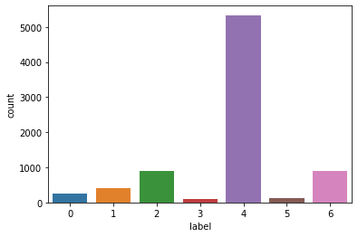
Dataset Introduction
The HAM10000 dataset is a large dataset of skin lesion images.[6]
Total Images : 10015
Total Classes : 7
AKIEC(0) , BCC(1), BKL(2), DF(3), NV(4), VASC(5), MEL(6)
This is a highly imbalanced dataset

Slide 12
Data preprocessing
Oversampling
A pre-processing technique that is used to balance the dataset by creating copies of the minority class examples.
Augmentation
A pre-processing technique that is used to increase the size of the dataset by applying random transformations to the existing images, such as rotation, flipping, and zooming.

Slide 13
Regularization techniques
Dropout
A regularization technique that is commonly used in deep learning to prevent over fitting. It works by randomly dropping out (i.e., setting to zero) a certain proportion of the neurons during the training process.[7]
Regularization
Regularization is a method to impose constraints on the model's parameters so that it can't fit the noise in the data.

Slide 14
Proposed Systems
To overcome problem of imbalance data
CNN on imbalanced data
CNN on oversampled data with dropout layer
CNN on augmented data with dropout layer
CNN using Regularization (L1) on augmented data with dropout
CNN using Regularization (L2) on augmented data with dropout
Resnet50 on oversampled data with dropout
VGG16 on Oversampled data with dropout

Slide 15
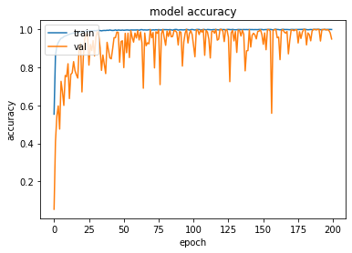
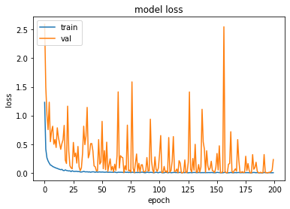
Results (Cont.)
Accuracy curve and loss curve for best model CNN
Fig : CNN accuracy curve
Fig : CNN loss curve

Slide 16
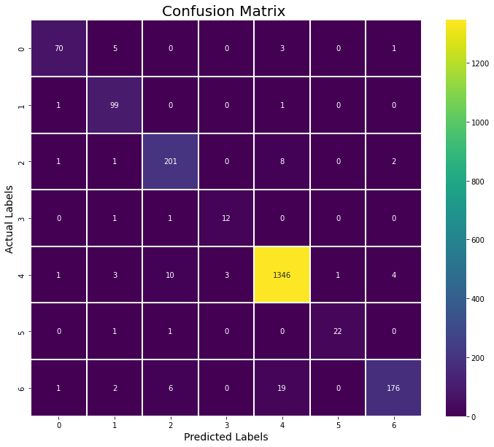
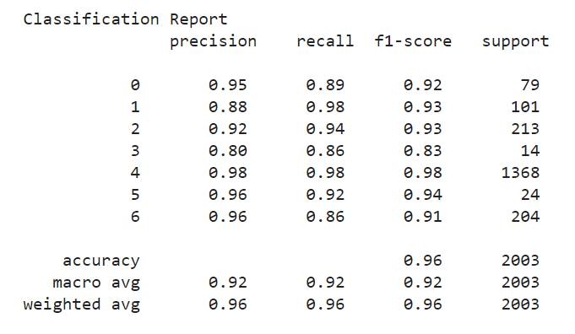
Results (Cont.)
Fig : CNN confusion matrix
Fig : CNN Classification report

Slide 17
Results (Cont.)
test_acc_with_img("/content/drive/MyDrive/testing image/akiec.jpg")
test_acc_with_img("/content/drive/MyDrive/testing image/bcc.jpg")
test_acc_with_img("/content/drive/MyDrive/testing image/bkl.jpg")
test_acc_with_img("/content/drive/MyDrive/testing image/df.jpg")
test_acc_with_img("/content/drive/MyDrive/testing image/mel.jpg")
test_acc_with_img("/content/drive/MyDrive/testing image/nv.jpg")
test_acc_with_img("/content/drive/MyDrive/testing image/vasc.jpg")
1/1 [==============================] - 0s 16ms/step ('akiec', 'actinic keratoses and intraepithelial carcinomae')
1/1 [==============================] - 0s 17ms/step ('bcc', 'basal cell carcinoma')
1/1 [==============================] - 0s 16ms/step ('bkl', 'benign keratosis-like lesions')
1/1 [==============================] - 0s 15ms/step ('nv', ' melanocytic nevi')
1/1 [==============================] - 0s 16ms/step ('mel', 'melanoma')
1/1 [==============================] - 0s 17ms/step ('nv', ' melanocytic nevi')
1/1 [==============================] - 0s 15ms/step ('vasc', ' pyogenic granulomas and hemorrhage')
Fig : Test model with unseen image (CNN)

Slide 18
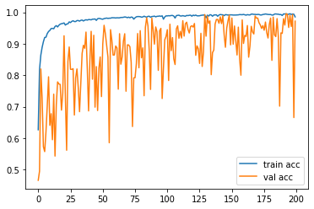
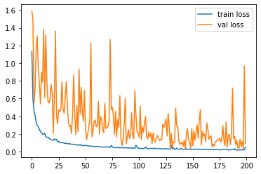
Results (Cont.)
Accuracy curve and loss curve for best model RestNet50
Fig : RestNet50 accuracy curve
Fig : RestNet50 loss curve

Slide 19

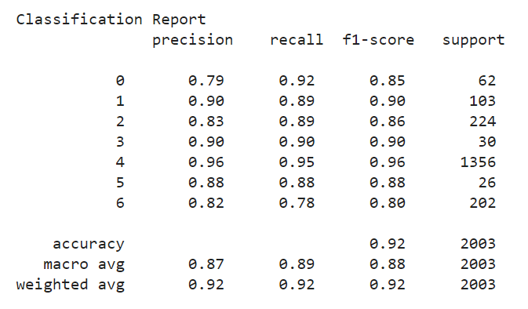
Results (Cont.)
Fig : RestNet50 confusion matrix
Fig : RestNet50 Classification report

Slide 20
Results (Cont.)
Models | Split | Accuracy | Precision | Recall | F1 score
1. CNN on imbalance data | 80%-20% | 73 | 49 | 41 | 43
2. CNN on oversampled data with dropout | 80%-20% | 96 | 92 | 92 | 92
3. CNN on augmented data with dropout | 80%-20% | 73 | 57 | 55 | 53
4. CNN using Regularization (L1) on augmented data with dropout | 80%-20% | 70 | 51 | 33 | 32
5. CNN using Regularization (L2) on augmented data with dropout | 80%-20% | 87 | 59 | 48 | 49
6. Resnet50 on oversampled data with dropout | 80%-20% | 92 | 87 | 89 | 88
7. VGG16 on oversampled data and with dropout | 80%-20% | 51 | 36 | 45 | 36

Slide 21
Results (Cont.)
test_acc_with_img("/content/drive/MyDrive/testing image/akiec.jpg")
test_acc_with_img("/content/drive/MyDrive/testing image/bcc.jpg")
test_acc_with_img("/content/drive/MyDrive/testing image/bkl.jpg")
test_acc_with_img("/content/drive/MyDrive/testing image/df.jpg")
test_acc_with_img("/content/drive/MyDrive/testing image/mel.jpg")
test_acc_with_img("/content/drive/MyDrive/testing image/nv.jpg")
test_acc_with_img("/content/drive/MyDrive/testing image/vasc.jpg")
1/1 [==============================] - 0s 16ms/step ('akiec', 'actinic keratoses and intraepithelial carcinomae')
1/1 [==============================] - 0s 17ms/step ('bcc', 'basal cell carcinoma')
1/1 [==============================] - 0s 16ms/step ('bkl', 'benign keratosis-like lesions')
1/1 [==============================] - 0s 15ms/step (‘vasc', ' pyogenic granulomas and hemorrhage ')
1/1 [==============================] - 0s 16ms/step ('mel', 'melanoma')
1/1 [==============================] - 0s 17ms/step ('nv', ' melanocytic nevi')
1/1 [==============================] - 0s 15ms/step ('vasc', ' pyogenic granulomas and hemorrhage')
Fig : Test model with unseen image (RestNet50)

Slide 22
CNN architecture (Best Model)
Input
Dense 5
Output
Conv2d 1
Max Pooling 1
Batch Norm 5
Conv2d 2
Dropout 3
Batch Norm
Conv2d 3
Dense 4
Batch Norm 4
Dense 3
Conv2d 4
Flatten
Dropout 2
Dropout 1
Dense 1
Dense 2
Max Pooling 2
Conv2d 5
Batch Norm 3
Batch Norm 1
Batch Norm 2

Slide 23
Result (Cont.)
Comparison with reported accuracy on reference paper and our model accuracy :
Model | Reference Paper Model Accuracy | Our model Accuracy
Modified mobile-net | 83%[1] | --
CNN | 86%[3] | 96%
RestNet50 | -- | 92%
VGG16 | -- | 51%

Slide 24
Conclusion & Future Work
The proposed system is capable of recognizing 7 skin lesion using CNN on HAM10000 Dataset.
In future, the model will be trained on more classes and more data to make model robust enough to classify most of the skin lesions.

Slide 25
References
[1] Sae-Lim, W., Wettayaprasit, W. and Aiyarak, P., 2019, July. Convolutional neural networks using MobileNet for skin lesion classification. In 2019 16th international joint conference on computer science and software engineering (JCSSE) (pp. 242-247). IEEE.
[2] Moldovan, D., 2019, November. Transfer learning based method for two-step skin cancer images classification. In 2019 E-Health and Bioengineering Conference (EHB) (pp. 1-4). IEEE.
[3] Hekler, A., Utikal, J.S., Enk, A.H., Hauschild, A., Weichenthal, M., Maron, R.C., Berking, C., Haferkamp, S., Klode, J., Schadendorf, D. and Schilling, B., 2019. Superior skin cancer classification by the combination of human and artificial intelligence. European Journal of Cancer, 120, pp.114-121.
[4] Kassem, M.A., Hosny, K.M. and Fouad, M.M., 2020. Skin lesions classification into eight classes for ISIC 2019 using deep convolutional neural network and transfer learning. IEEE Access, 8, pp.114822-114832.
[5] Goyal, M., Oakley, A., Bansal, P., Dancey, D. and Yap, M.H., 2019. Skin lesion segmentation in dermoscopic images with ensemble deep learning methods. IEEE Access, 8, pp.4171-4181.

Slide 26
References
[6] Tschandl, P., Rosendahl, C. and Kittler, H., 2018. The HAM10000 dataset, a large collection of multi-source dermatoscopic images of common pigmented skin lesions. Scientific data, 5(1), pp.1-9.
[7] Srivastava, N., Hinton, G., Krizhevsky, A., Sutskever, I. and Salakhutdinov, R., 2014. Dropout: a simple way to prevent neural networks from overfitting. The journal of machine learning research, 15(1), pp.1929-1958.

Slide 27
Question & Answer Session

Slide 28
Thank You

